Slide 1
Validation Inputs

Slide 2
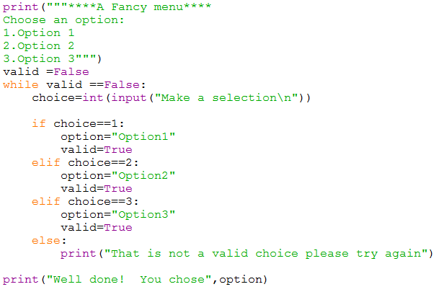
Task 1: Write a program that asks the user to enter a number between 1 and 5. Use a loop to validate the integer value that they enter.

Slide 3
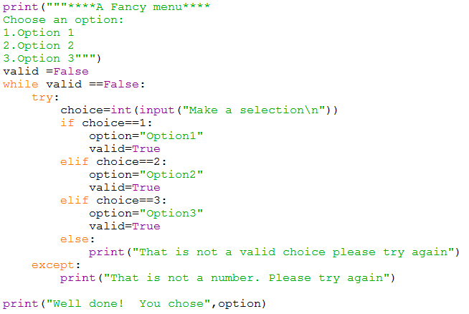
Task 2: Amend the above code to include a try:/except: validation to catch non integer values being entered.

Slide 4
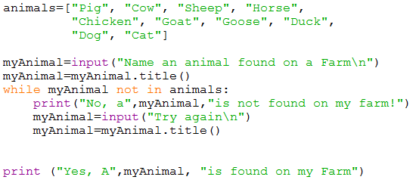
Task 3&4: Write a program that asks the user to enter an animal found on a farm. Validate their entry using the list. Output an appropriate message.

Slide 5
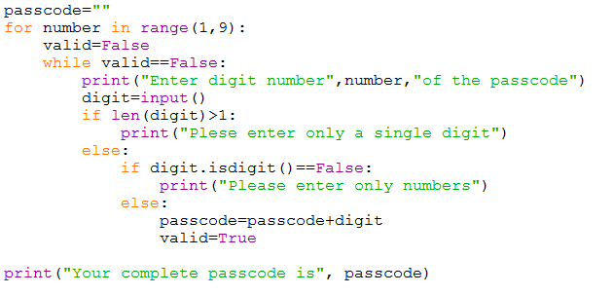
Task5: A security system uses a passcode that contains 8 numbers stored as a single string (it is possible for the first character to be zero). Write a program that will accept individual entries for each of the 8 numbers in the passcode.

Slide 6
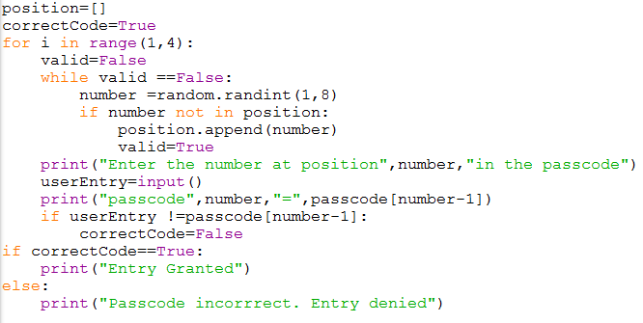
Use the passcode from task 5. Write a program that randomly select 3 numbers from the passcode at three different positions. The user should enter the numbers at each position.

